Slide 1

CeeScoresLive
By Connor Ngouana

Slide 2
Overview
About and Why,
I made this project
Architecture Diagram
Technical Analysis
Research
Project Planning
Features
Engagement

Slide 3

About
Why
CeeScoresLive is a website made for football lovers like me that are also too busy with other commitments to watch the matches live. This project was made to help people see score from live, past and future matches, statistics from your favorite teams, a live chat to talk to your friends about the match or teams also a quiz to enjoy while on the website to test your ball knowledge.
The reason I created this project was because of my love for football and wanting to create something that could build a community of football fans that would gather and use my web application, so I decided to created my own website to gather like minded football fans to view scores live or chat to other users about fixture or their favorite teams.

Slide 4
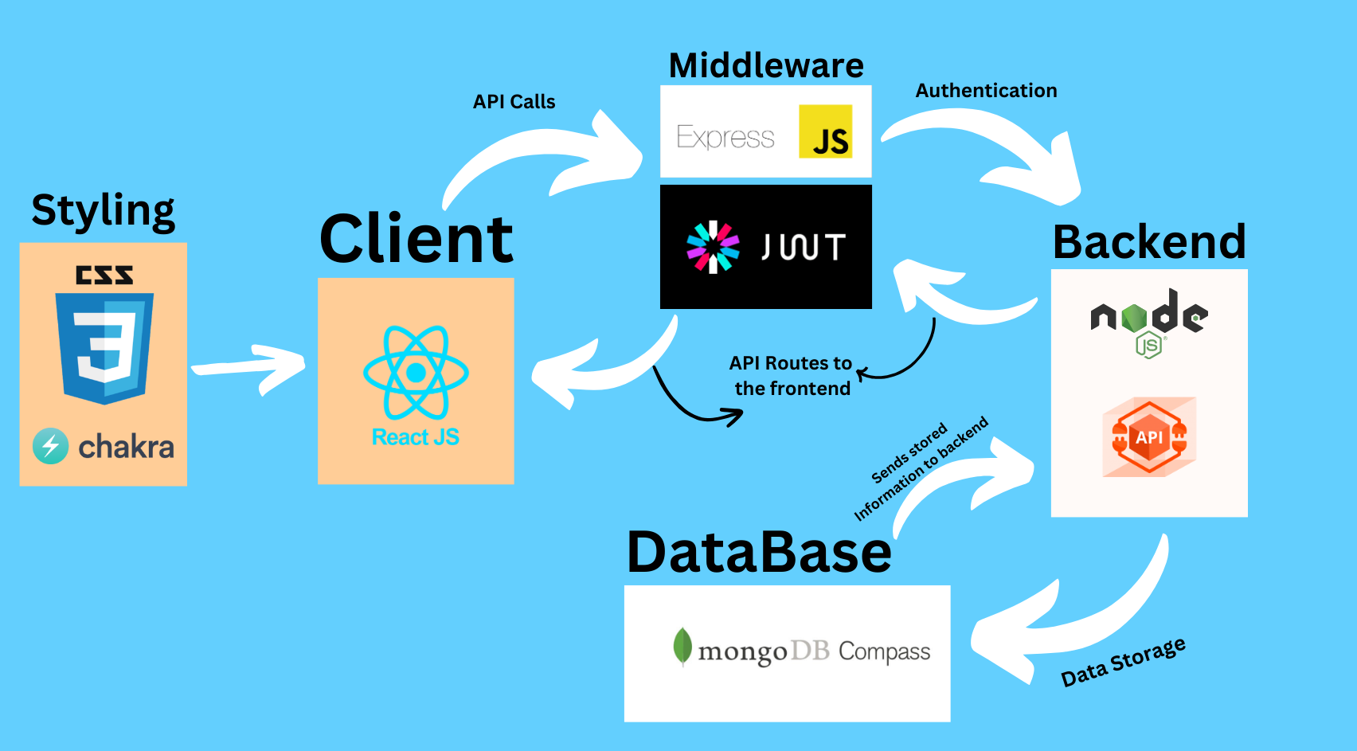

Slide 5

Technical Analysis
FrontEnd
React.js
React Js is an open-source JavaScript library.
Used to create the Web Application.
CSS
CSS is the language we use to style a Web page.
I used CSS to style pages like my NavBar.
Chakra UI.
Chakra UI is a modern component library for React applications.
I used chakra UI styling for my overall project to make it look better for the users.
BackEnd
Node.js
Node.js is a JavaScript runtime.
I use this to create the backend
Express.js
Express is a lightweight and flexible routing framework.
I used this to connect the frontend and the backend to allow the API routes created in the backend be used in the frontend.
MongoDB
MongoDB stores data as JSON documents.
I used this to store data gathered by the frontend and backend.
Additional Technologies
RapidApi
RapidAPI, is a marketplace for API so people can buy and sell API.
I used Rapid API to generate real time data like the league table.
Middleware – JWT/Cookies
I used this to authenticate users and to protect the user’s information so someone with a different/no token can’t access your profile.
Socket.io
Socket.io enables real time communication.
I used this for my chat so that it sends messages in real time without refreshing the page

Slide 6

Research
Socket.io
Youtube – (https://youtu.be/djMy4QsPWiI?si=GL3ywM6Ye-6EsUZB)
React
Youtube – (https://youtu.be/SqcY0GlETPk?si=HTrkEmj7bk6mVnOe)
Docs – (https://blog.hubspot.com/website/react-js#:~:text=js%3F-,React.,reusable%20piece%20of%20HTML%20code)
Youtube MERN Stack Tutorials
Node – Brian O’Shea Class work,
Docs - (https://nodejs.org/en)
Youtube MERN Stack Tutorials
JWT
Youtube – (https://youtu.be/XPC81RWOItI?si=WL6U4zMJU887-l1y)
Express – Brian O’Shea Class work
Docs – (https://expressjs.com/)
Youtube - MERN Stack Tutorials
Chakra UI
Docs – (https://chakra-ui.com/docs/components)
Youtube – (https://www.youtube.com/watch?v=iXsM6NkEmFc&list=PL4cUxeGkcC9hcnIeryurNMMcGBHp7AYlP)
RapidAPI
Docs – (https://rapidapi.com/api-sports/api/api-football/tutorials)
MongoDB – Brian O’Shea Class work
Docs – (https://www.mongodb.com/docs/compass/current/#:~:text=MongoDB%20Compass%20is%20a%20powerful,Download%20Compass)
Youtube – MERN Stack Tutorials

Slide 7
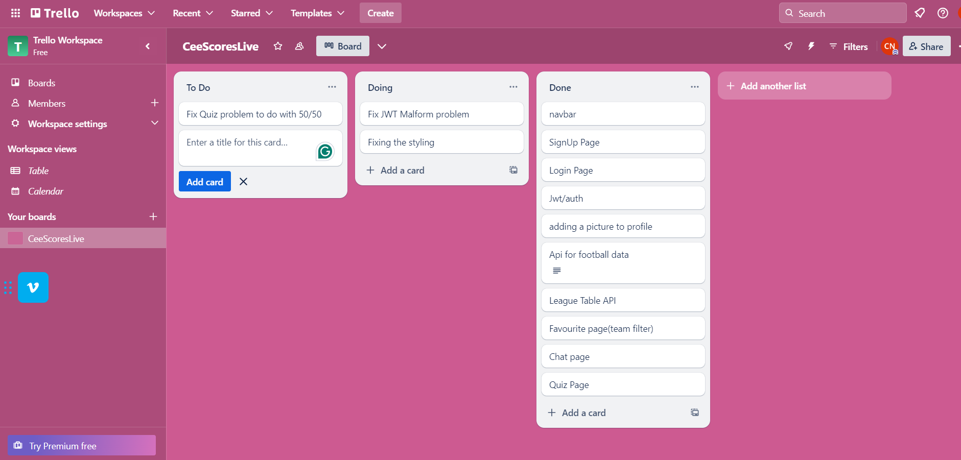
Project Planning
Trello - Trello is the visual tool that manages any type of project, workflow, or task tracking.
Kanban - The main purpose of Kanban is representing work as a card on the Kanban board is to allow me to track progress through its workflow in a highly visual manner.
Trello is an ideal platform for Kanban. You can easily configure the Board to match your process. I was able to track my work as you can see in the diagram by splitting my work into 3 headings To do, Doing and Done.

Slide 8
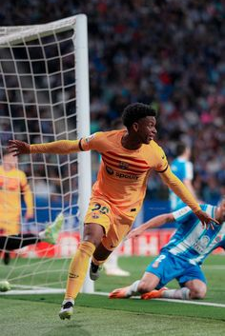
Features
Login/SignUp/Logout/Authentication
Image upload
Table/Scores/News - Football
Favourite a team (Extra Stats)
Live/Real time chat
Quiz
User Profiles
Client to Server communication
Amazing UI

Slide 9
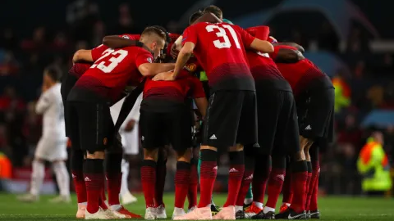
Engagement
Stand-Ups with students in class
Talking to teacher about my project
Asking students doing similar project for feedback or improvements

Slide 10
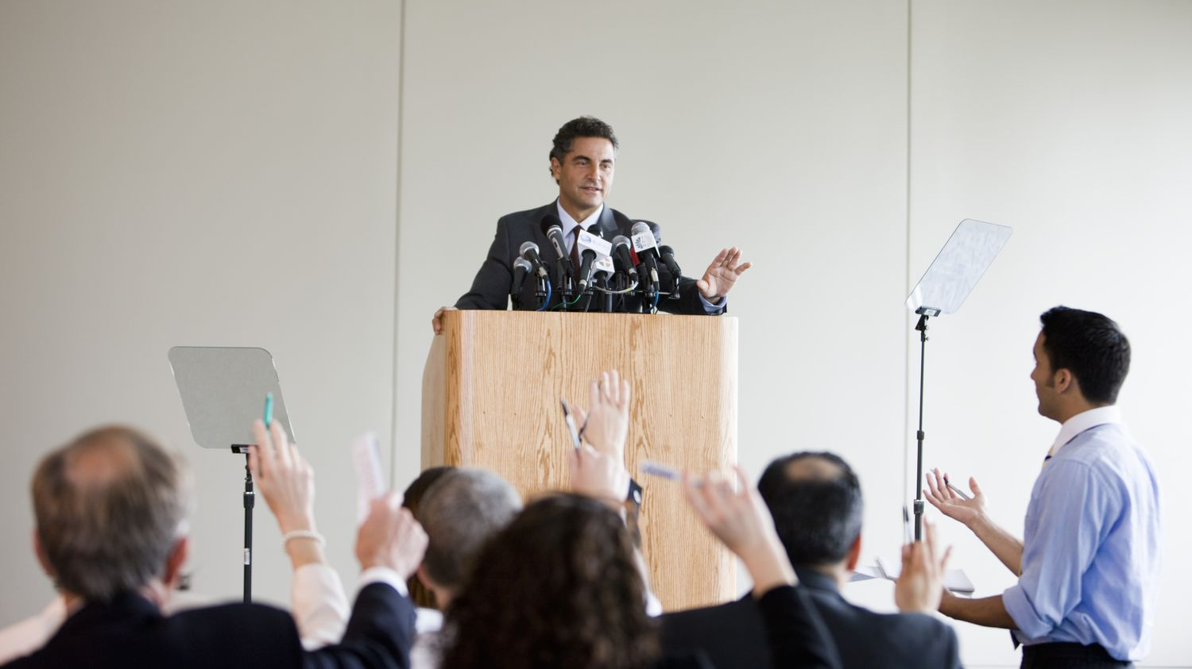
Demonstrations
Come to my desk and let's see what I have done

Slide 11

Thank you

